Slide 1
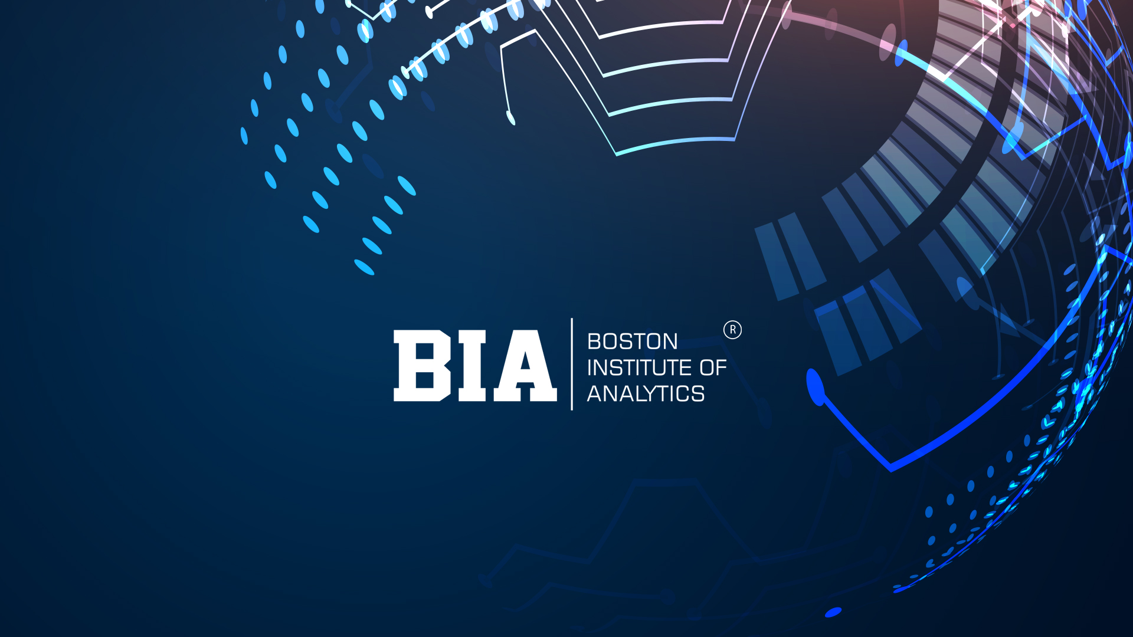

Slide 2

Credit Card Usage Segmentation Analysis
Presented By :- Jatin Meena
Credit card usage segmentation divides customers into groups based on their spending habits, lifestyle, and needs to enable personalized marketing, targeted product offerings, and improved risk management. Common segmentation models consider purchase behavior, cash usage, installment preferences, and lifestyle to identify distinct customer groups, allowing financial institutions to tailor their strategies for greater customer engagement and loyalty.

Slide 3
Agenda
01
Introduction
02
STEPS INVOLVED
03
DATA OVERVIEW AND PREPROCESSING
04
EXPLORATORY DATA ANALYSIS
05
CLUSTERING
06
CLUSTER EVALUATION
07
APPLICATIONS AND BENEFITS
08
Conclusion

Slide 4

INTRODUCTION
This project focuses on developing unsupervised learning models for customer segmentation based on credit card usage data. The models aim to provide insights into distinct customer segments, improve credit risk assessment, and optimize marketing strategies. Deliverables include segmentation models, comprehensive data visualizations, and a comparative analysis of various algorithms.

Slide 5




STEPS INVOLVED IN DEVELOPING “CREDIT CARD USAGE SEGMENTATION”
3
Step – 1
Collection Data from various source
Step – 2
Data Cleaning and Feature Engineering
Step – 3
Model Building for selecting correct ML Algorithm
Step – 4
Evaluate Model

Slide 6
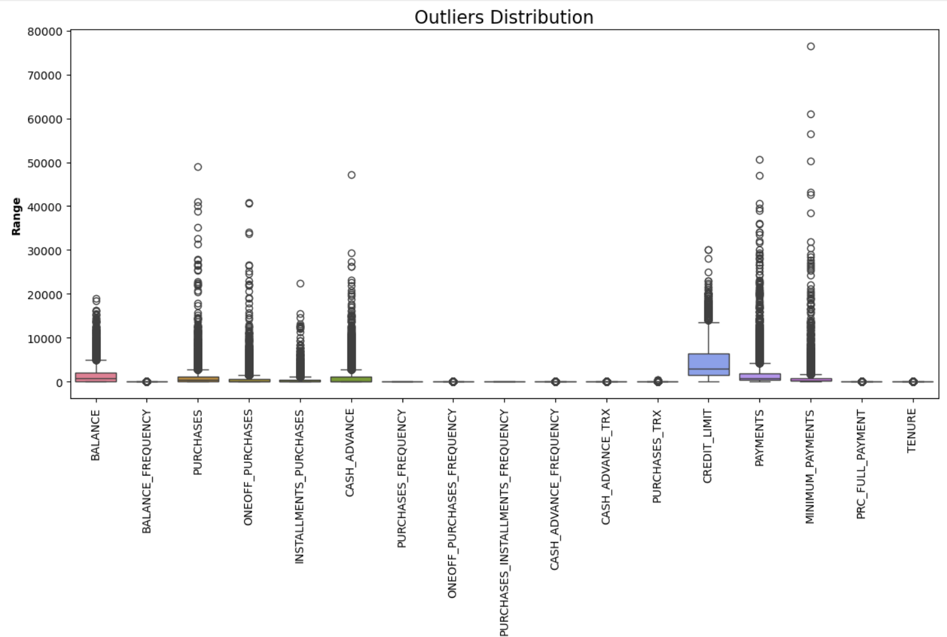
DATA OVERVIEW AND PREPROCESSING
4
01
Dataset Features
02
The dataset contains 18 variables related to credit card usage and customer behaviour.
Data Cleaning
Missing values in CREDIT_LIMIT and MINIMUM_PAYMENTS were imputed using median values.
03
Outlier Detection
IQR method identified 695 outliers in the BALANCE variables.

Slide 7
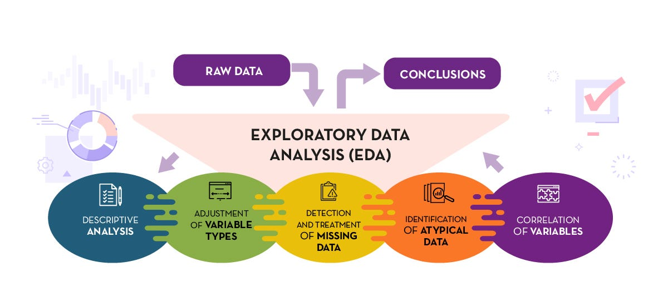
EXPLORATORY DATA ANALYSIS
Exploratory Data Analysis (EDA) is a critical step in understanding the dataset and uncovering patterns, relationships, and insights that will inform the segmentation process. In the case of credit card usage segmentation, EDA helps to understand how customers purchases and demographics relate to each other, identifying trends that can aid in customer segmentation.
The EDA process for Credit Card Usage Segmentation :
Understand the Structure of the Data
Summary Statistics
Handling Missing Data
Analyzing the Data
Filling Missing Values

Slide 8
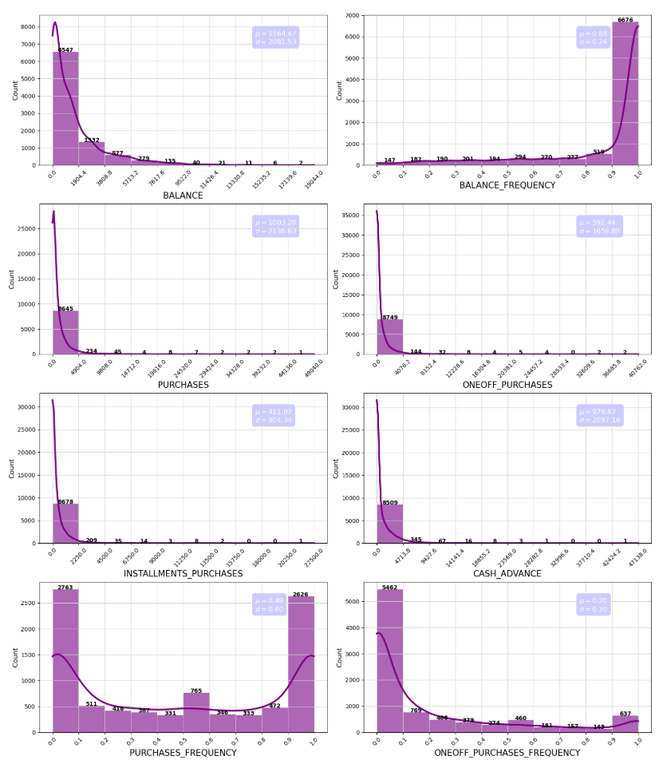
Univariate Analysis
Inferences:
BALANCE:
Most customers maintain low to moderate balances, but a few carry very large balances.
PURCHASES vs. ONEOFF_PURCHASES vs. INSTALLMENTS_PURCHASES:
Different spending patterns exist: some customers prefer one-off big transactions, others prefer installments.
CASH_ADVANCE:
Many customers never take cash advances (spike at 0), but a subset relies heavily on them.

Slide 9
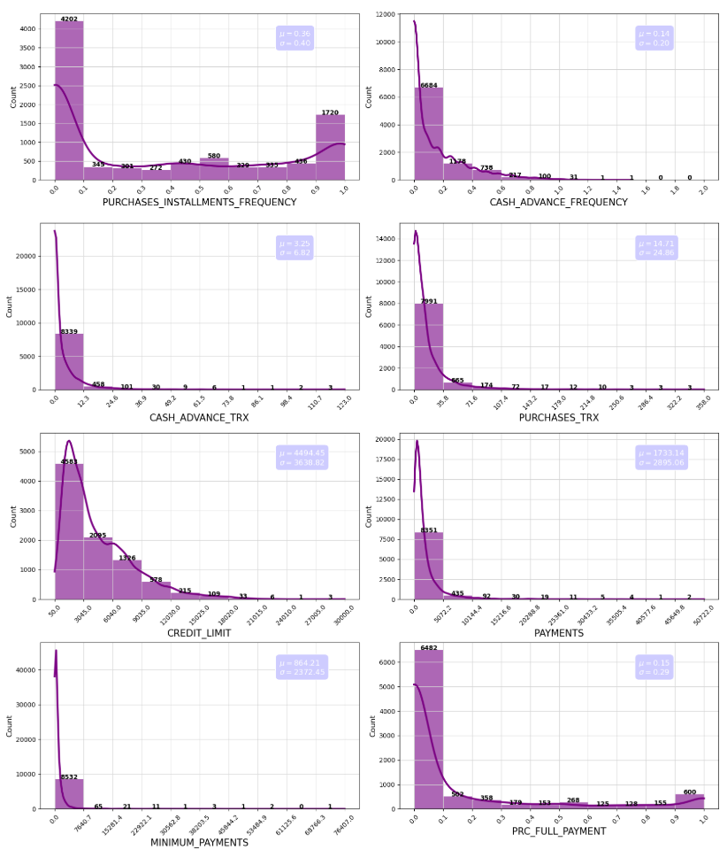
Univariate Analysis
Inferences:
CREDIT_LIMIT:
Distribution suggests tiered assignment by the bank (e.g., groups around 1500, 5000, 10000).
PAYMENTS:
While most customers pay moderately, some repay extremely high amounts, possibly high-spending but also responsible customers.
MINIMUM_PAYMENTS:
The high variance indicates different risk levels: some pay only the minimum, others much more.
PRC_FULL_PAYMENT:
Distribution skewed toward 0, meaning most customers don’t pay in full regularly.

Slide 10
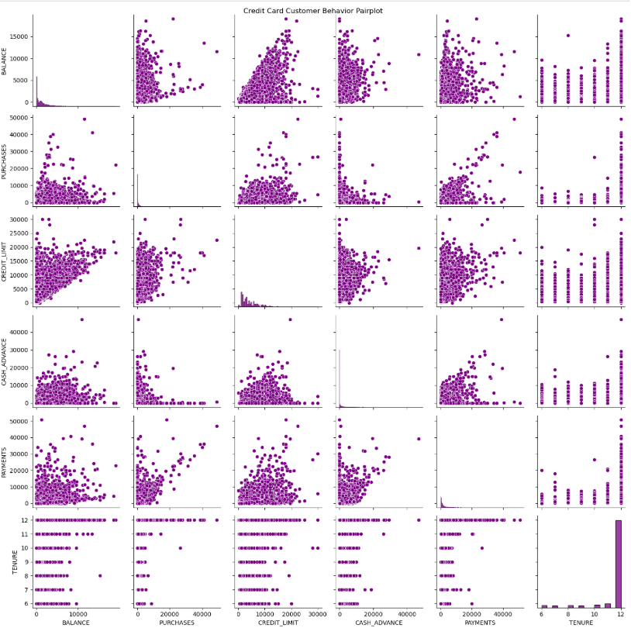
Multivariate analysis
Inferences:
Balance vs. Credit Limit :
Customers with higher credit limits tend to have higher balances, but not always proportionally.
Some customers have high limits but low balances, suggesting low utilization (possibly low-risk, conservative customers).
Others max out their limits → risky or high-need customers.
Purchases vs. Payments :
Strong positive relationship: high spenders also make high payments.
However, some customers show large purchases but low payments → they rely on credit rollovers, increasing default risk.
A few show low purchases but very high payments, possibly making lump-sum repayments (e.g., clearing balance after inactivity).
One-off vs. Installment Purchases
Customers cluster into :
One-off dominant spenders (big purchases, irregular).
Installment-heavy users (smaller but regular payments).
Balanced users (engage in both).
This split can be used for behavioral segmentation (e.g., luxury shoppers vs. regular household spenders).
Cash Advance vs. Payments :
High cash advance users often also have high payments, but many sit at zero.
Cash advance frequency shows a subset of customers who rely heavily on cash withdrawal, suggesting possible liquidity issues.
Purchase Frequency vs. Purchase Amount :
Some customers purchase frequently but with small amounts (everyday users).
Others purchase rarely but with large one-off amounts (occasional big spenders).
This separation is very useful for customer lifecycle marketing strategies.

Slide 11
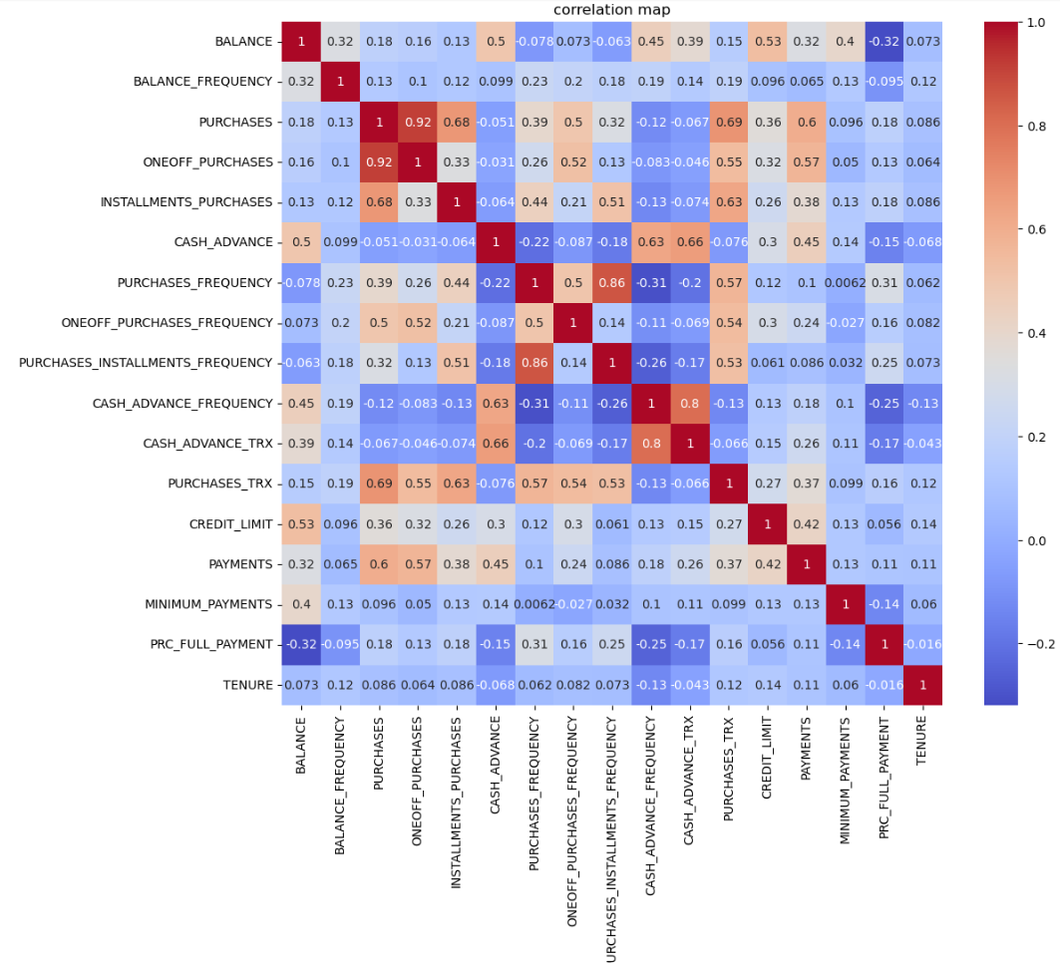
Correlation Heatmap analysis
Inferences:
* Customers can be segmented into installment-heavy vs. one-off purchase-heavy groups.
* Cash advance behavior is a separate pattern (strong within itself but weakly related to purchases).
* Full payment customers maintain lower balances and are financially healthier.
* Credit limit plays a role in balance accumulation, but not strongly tied to payment behavior.

Slide 12
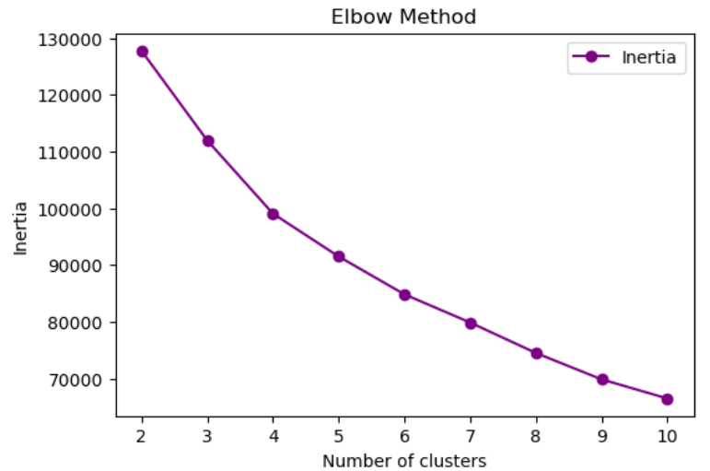
Clustering
1
K-Means Algorithm
2
Elbow Method
3
Silhouette Score

Slide 13
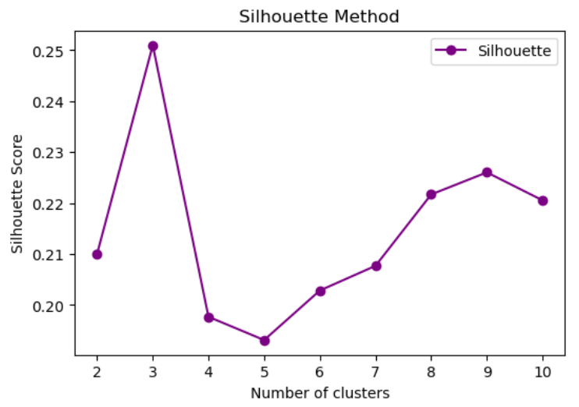
Cluster Evaluation
Analyze Insights:
* Highest Silhouette Score at k=3 (~0.25)
The best clustering solution appears at 3 clusters, since it gives the highest average silhouette score (better separation between clusters and cohesion within clusters).
* Scores drop significantly after k=3
At k=4 and k=5, the silhouette score decreases, meaning clusters overlap more and aren’t well separated.
* Slight improvement for k=8–9, but not better than k=3
While the silhouette score improves for larger clusters, it never surpasses the score for k=3.

Slide 14
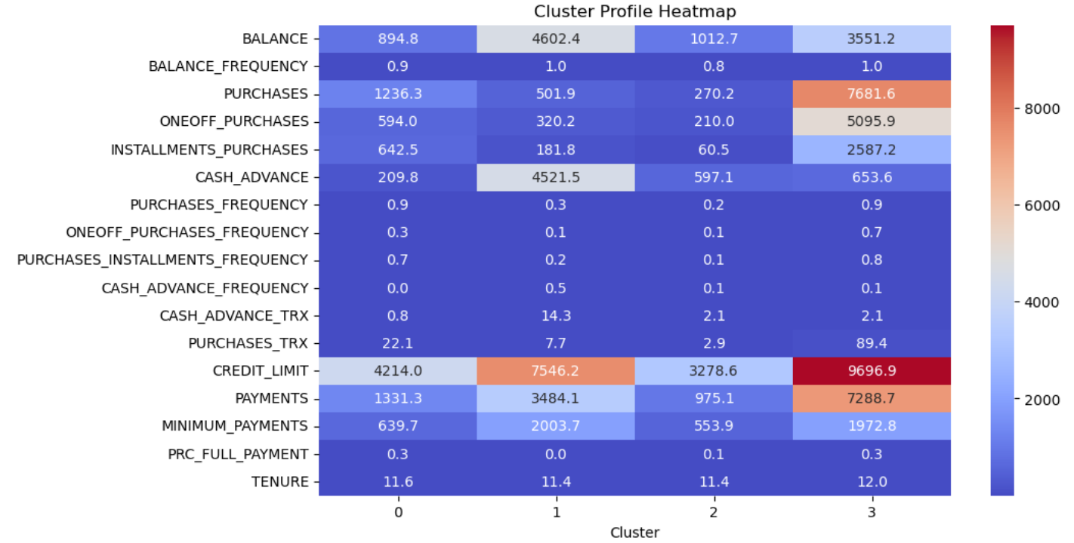
Cluster Evaluation
K-Means Clustering:
Inferences:
Cluster 0 = Low spend, low balance users (safe customers).
Cluster 1 = Heavy one-off spenders, pay in full.
Cluster 2 = Cash-advance reliant, risky customers.
Cluster 3 = High limit, high spending, high repayment customers (VIPs).

Slide 15
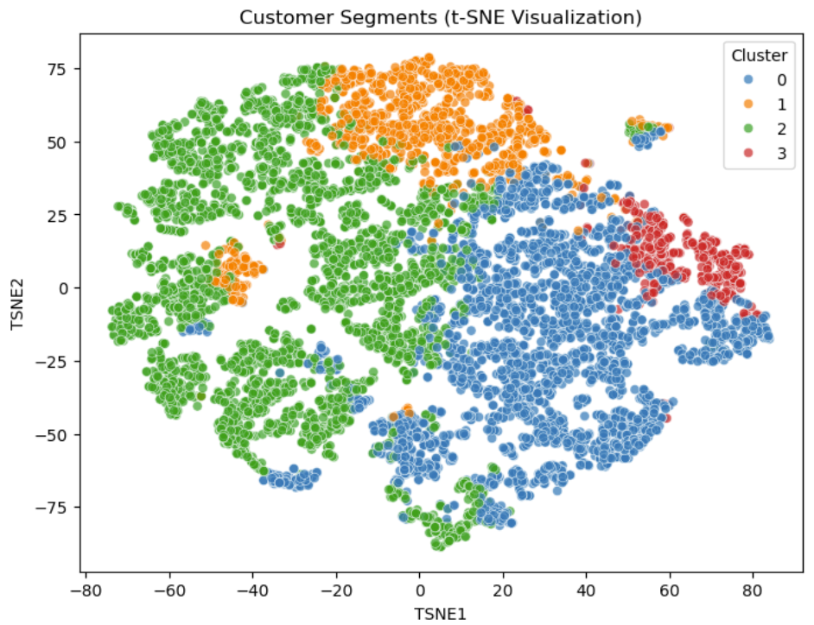
Cluster Evaluation
T-SNE Clustering:
Inferences:
Observations from the plot
Distinct Segments
Four clusters are clearly separated (blue = 0, orange = 1, green = 2, red = 3).
t-SNE reduced high-dimensional data into 2D, and we can see good separation, meaning the clustering is capturing meaningful differences between customers.
Cluster Sizes
Cluster 2 (green) is the largest segment — a big proportion of customers share similar characteristics.
Cluster 0 (blue) is also large, possibly the second-biggest group.
Cluster 1 (orange) and Cluster 3 (red) are smaller but still meaningful.
Smaller clusters may represent niche but valuable customer groups (e.g., premium buyers).
Cluster Proximity
Clusters 0 (blue) and 3 (red) are closer together → customers in these groups may have overlapping behavior (maybe mid-value vs high-value).
Cluster 2 (green) spreads widely → possibly very diverse customers grouped together.
Cluster 1 (orange) is more compact → these customers are more homogeneous (share similar traits).
Business Implications
Cluster 2 (Green): Mass-market segment, likely price-sensitive, large volume.
Cluster 0 (Blue): Strongly differentiated group, potential loyal customers.
Cluster 3 (Red): Smaller, but could be high-value or premium customers.
Cluster 1 (Orange): Tight-knit niche — good for targeted campaigns.

Slide 16
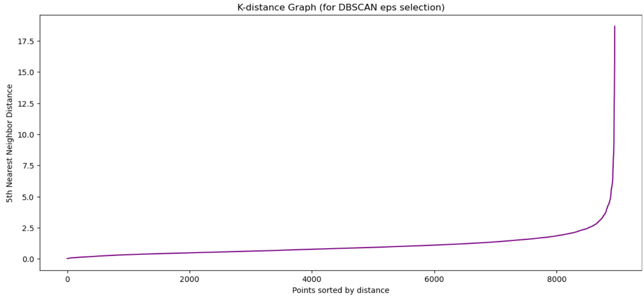
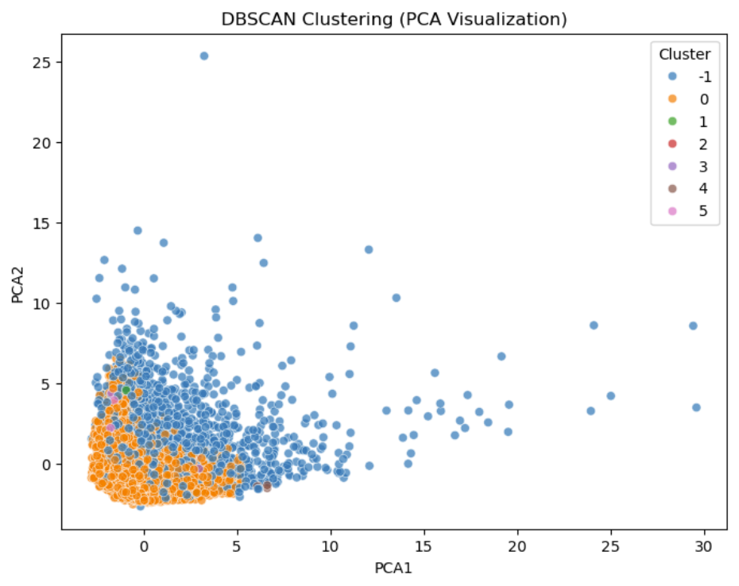
Cluster Evaluation
DBSCAN:
The main difference: DBSCAN may find fewer, more natural clusters and identify outlier customers who don’t fit into any segment (important for fraud/risk detection).

Slide 17
Applications and benefits
Targeted Marketing:
Enables personalized marketing strategies for different customer segments, leading to higher engagement and conversion rates.
Risk Management:
Identifies high-risk customer segments for proactive credit monitoring and risk mitigation, reducing potential defaults.
Customer Retention:
Offers insights to develop loyalty programs and personalized rewards, increasing customer satisfaction and retention.
Product Development:
Supports data-driven decisions for designing credit card product and services tailored to specific customer needs.
Operational Efficiency:
Streamlines resources by focusing on high-value or high-risk segments, optimizing resource allocation.

Slide 18
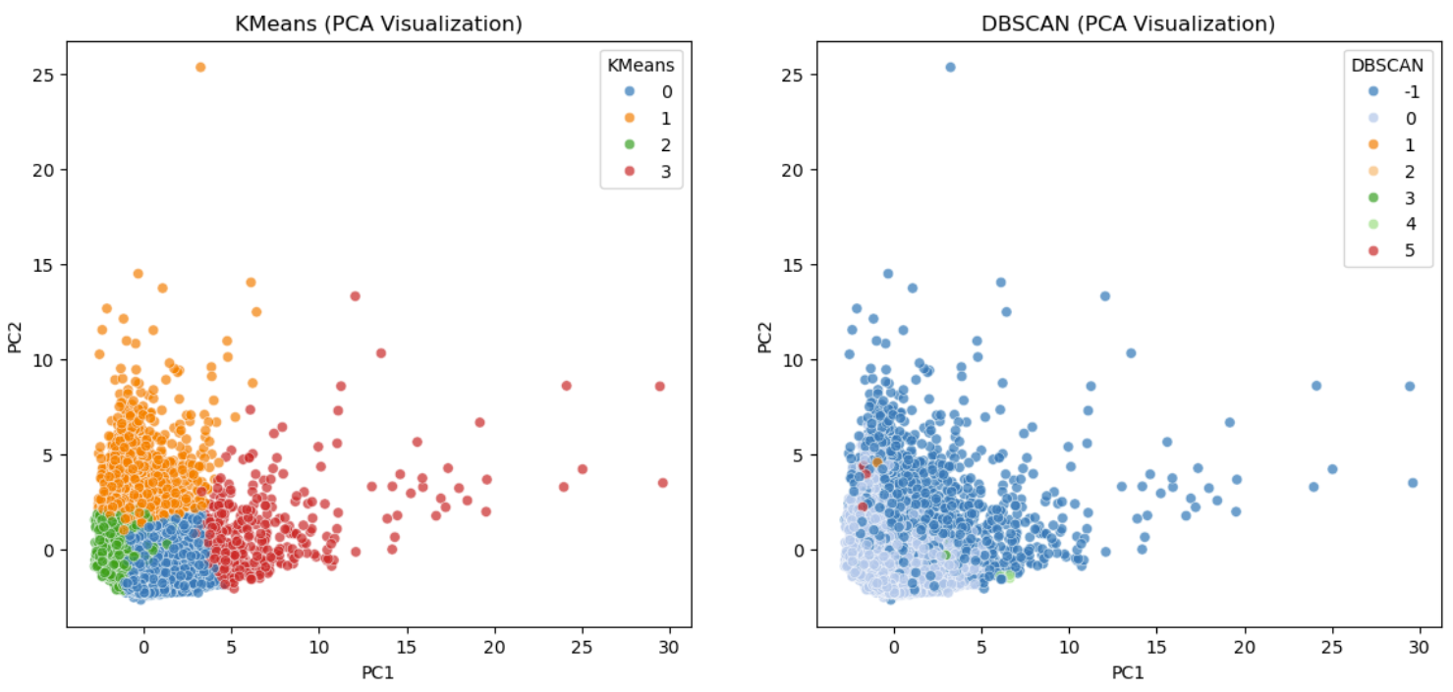
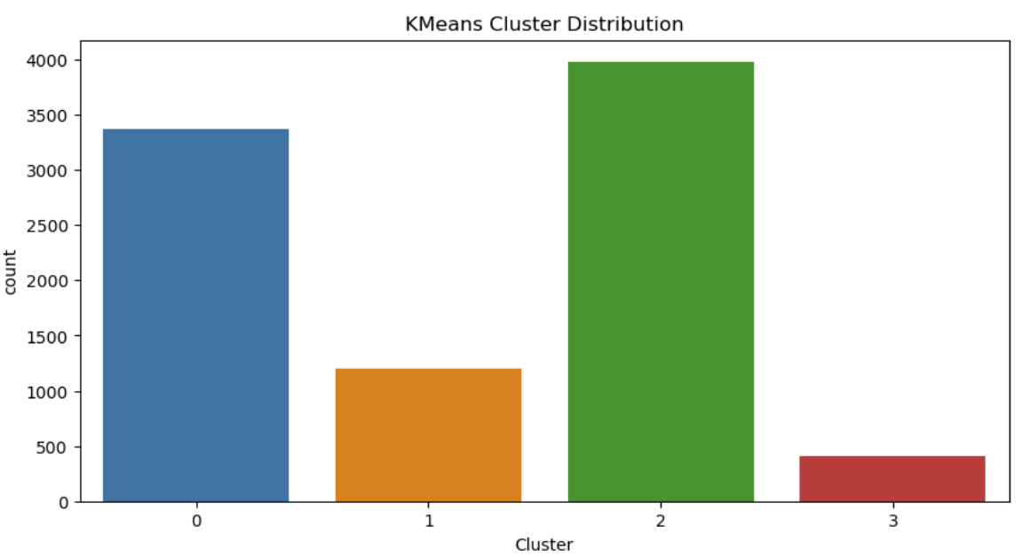
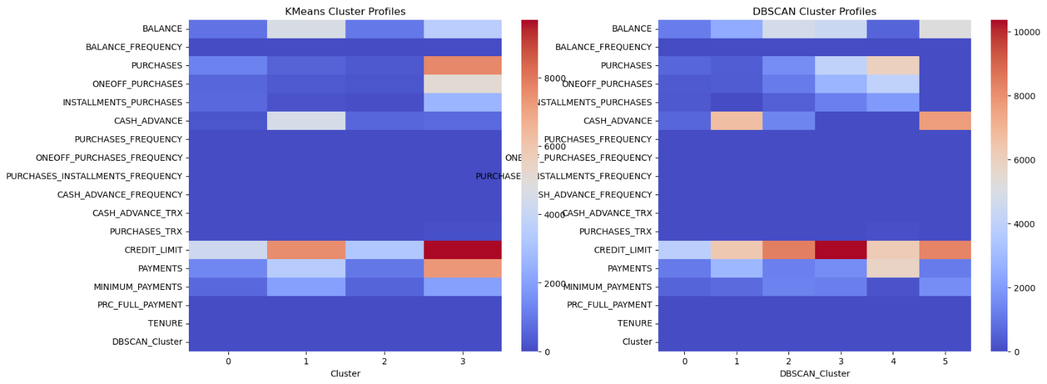
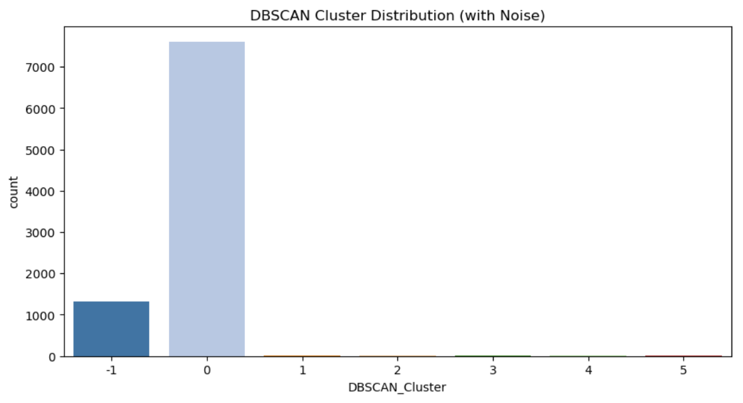
Conclusion
COMPARISON: K-Means vs DBSCAN

Slide 19
Conclusion
Successful Customer Segmentation : Identified distinct customer groups based on usage patterns, providing deeper insights.
Targeted Marketing Opportunities : Enabled personalized marketing strategies to improve engagement and response rates.
Enhanced Risk Management : Identified high-risk segments for proactive credit risk management.
Improved Customer Retention : Potential for tailored rewards and services to increase customer loyalty.
Algorithm Performance Analysis : Evaluated multiple algorithms to select the most effective segmentation approach.
Future Scope : Possibilities for further insights by incorporating transaction-level data and exploring supervised models.

Slide 20
Questions ?

Slide 21
Thank you
Jatin Meena
9311642067
jatink478@gmail.com

